Slide 1

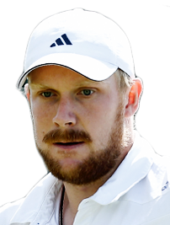
Matthias
BACHINGER

Slide 2
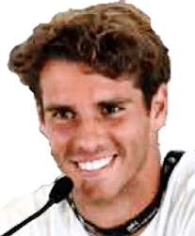
Filippo
BALDI

Slide 3
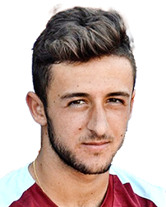
Javier
BARRANCO COSANO

Slide 4
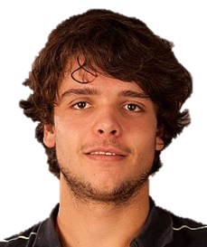
Grégoire
BARRERE

Slide 5
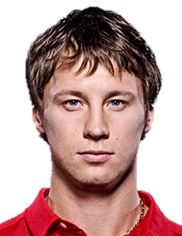
Ricardas
BERANKIS

Slide 6
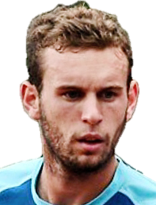
Mathias
BOURGUE

Slide 7
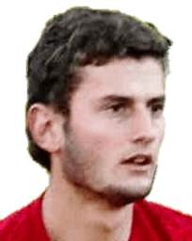
Raul
BRANCACCIO

Slide 8
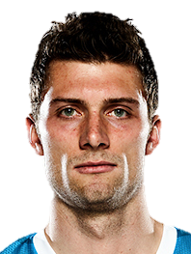
Daniel
BRANDS

Slide 9
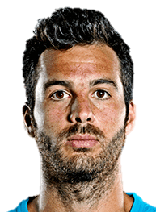
Salvatore
CARUSO

Slide 10
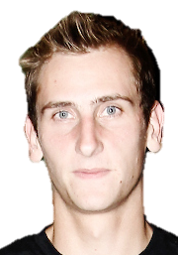
Thiemo
DE BAKKER

Slide 11
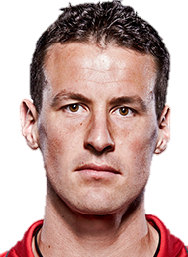
Kenny
DE SHEPPER

Slide 12
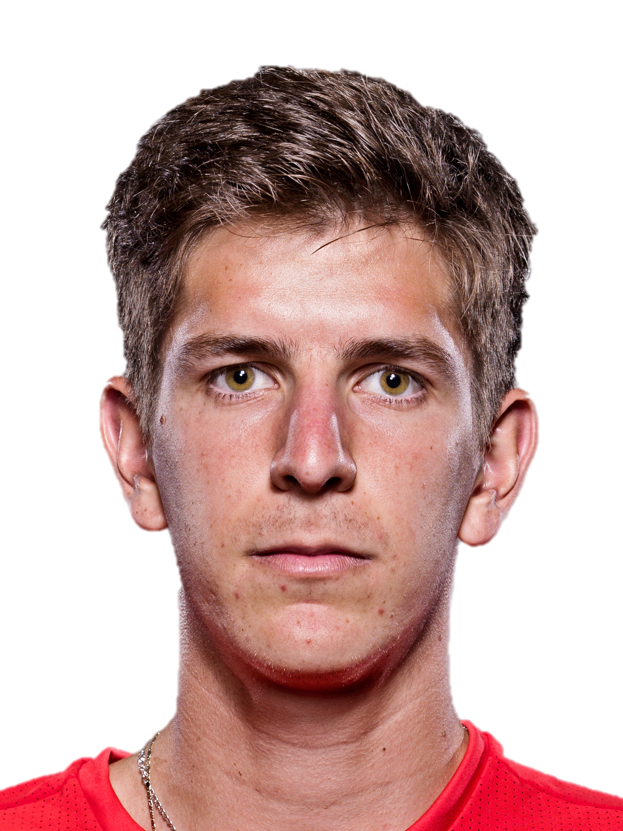
Matteo
DONATI

Slide 13
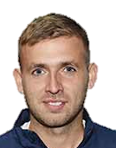
Daniel
EVANS

Slide 14
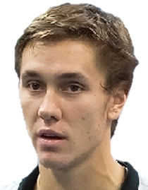
Egor
GERASIMOV

Slide 15
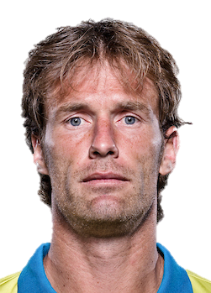
Daniel
GIMENO-TRAVER

Slide 16
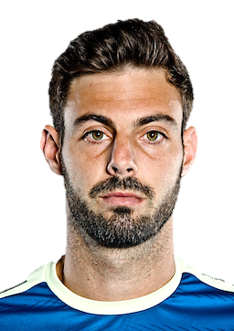
Marcel
GRANOLLERS

Slide 17
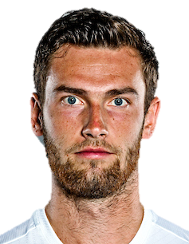
Quentin
HALYS

Slide 18
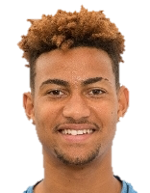
Calvin
HEMERY

Slide 19
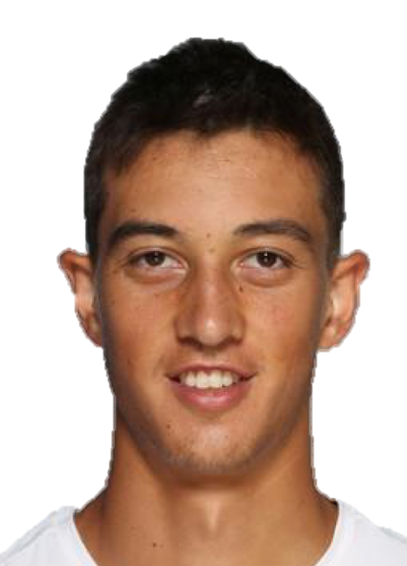
Antoine
HOANG

Slide 20
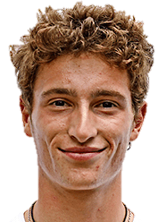
Ugo
HUMBERT

Slide 21
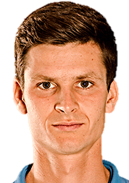
Hubert
HURKACZ

Slide 22
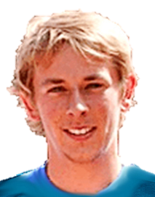
Grégoire
JACQ

Slide 23
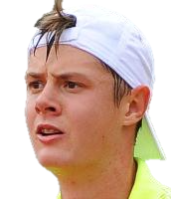
Maxime
JANVIER

Slide 24
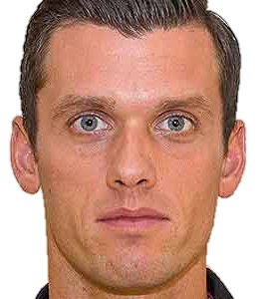
Tobias
KAMKE

Slide 25
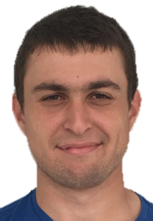
Aslan
KARATSEV

Slide 26
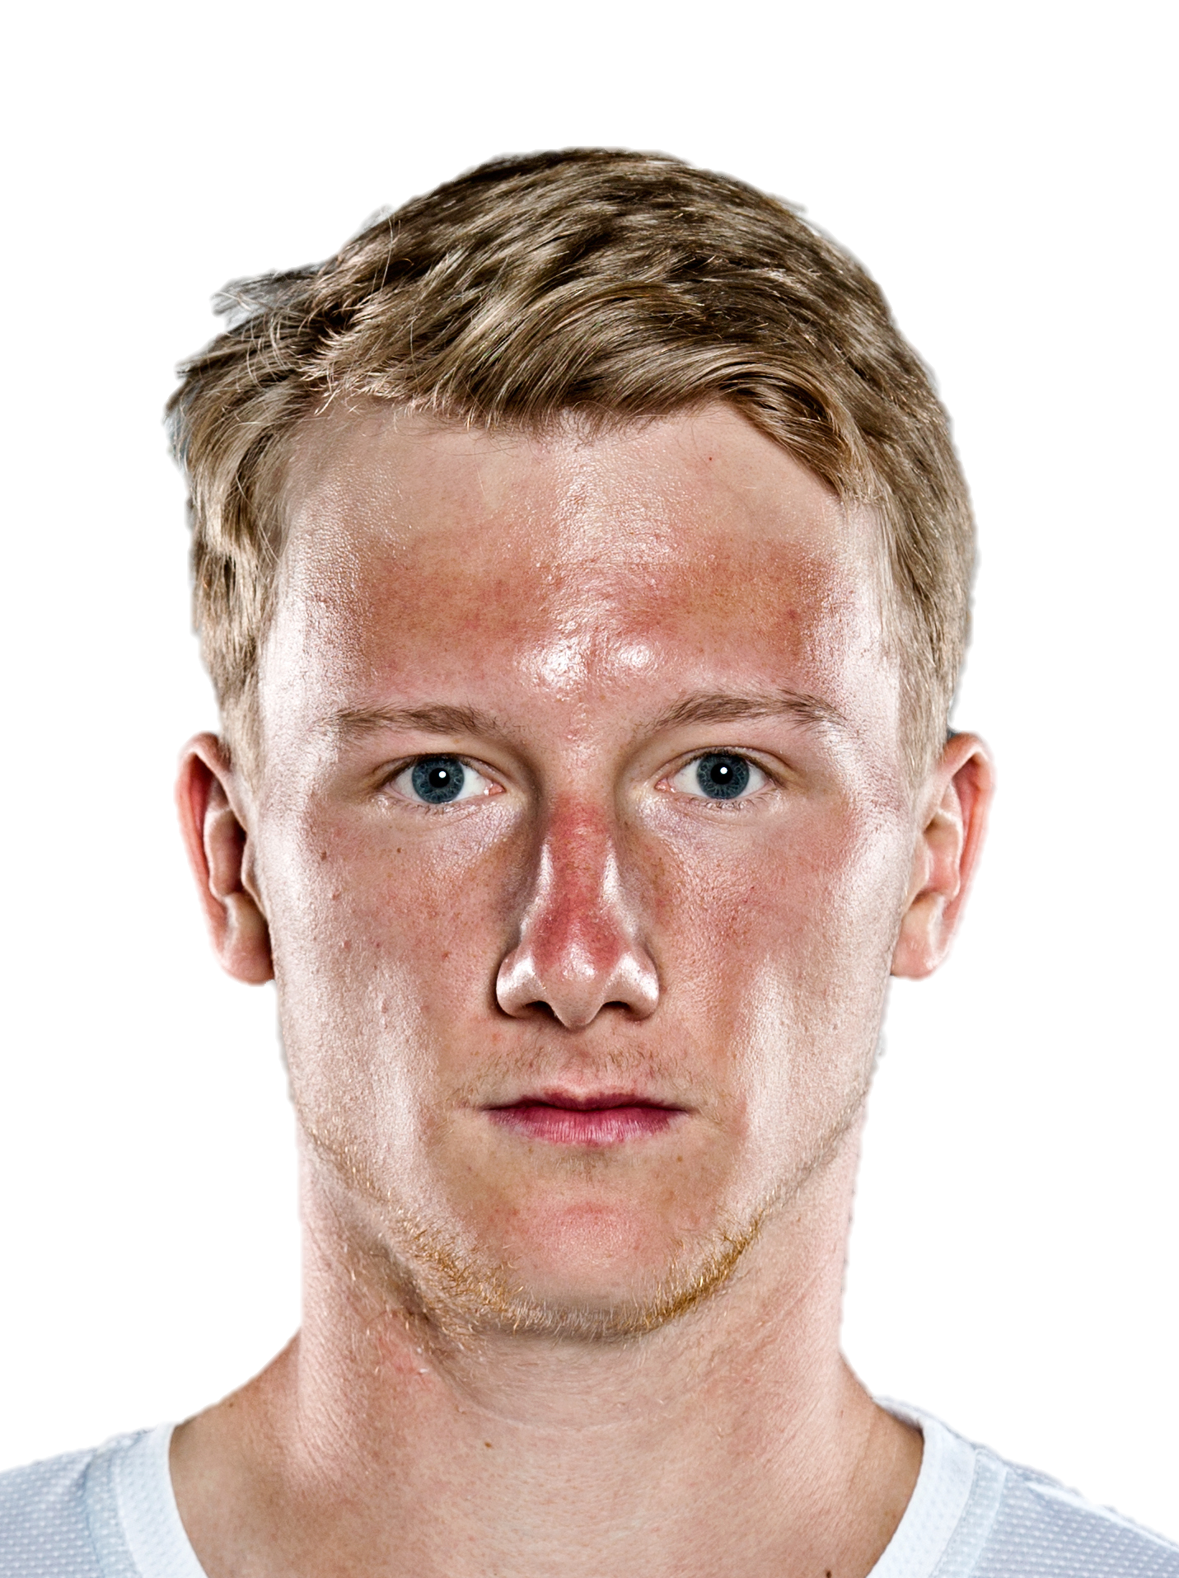
Zdenek
KOLAR

Slide 27
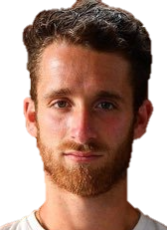
Constant
LESTIENNE

Slide 28
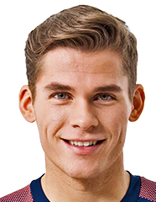
Daniel
MASUR

Slide 29
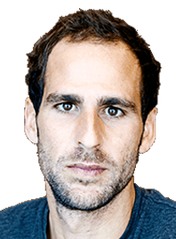
Adrian
MENENDEZ MACEIRAS

Slide 30
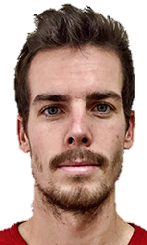
Mats
MORAING

Slide 31
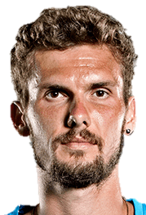
Oscar
OTTE

Slide 32
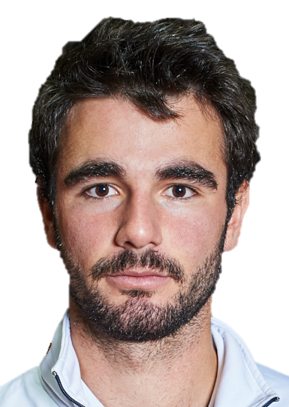
Fabien
REBOUL

Slide 33
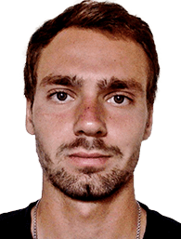
Roman
SAFIULLIN

Slide 34
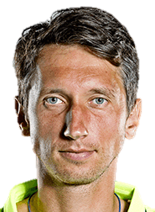
Sergiy
STAKHOVSKY

Slide 35
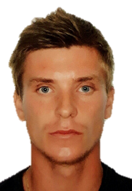
Alexey
VATUTIN

Slide 36
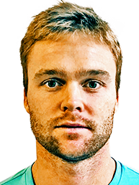
Jurgen
ZOPP

Slide 37
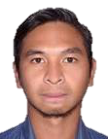
Christopher
RUNGKAT

Slide 38
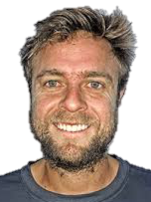
Fabricio
NEIS

Slide 39
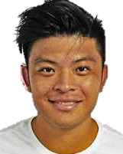
Hsieh
CHENG PENG

Slide 40
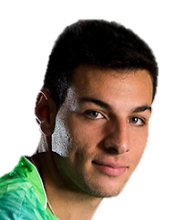
Bernabe
ZAPATA MIRALLES

Slide 41
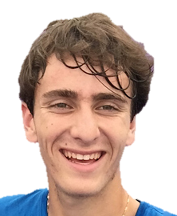
Elliot
BENCHETRIT

Slide 42
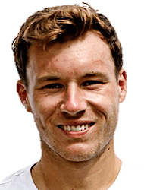
Lucas
MIEDLER

Slide 43
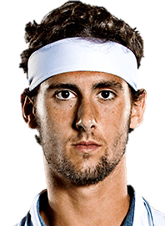
Carlos
TABERNER

Slide 44
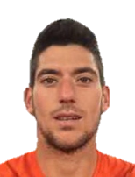
Roberto
ORTEGA-OLMEDO

Slide 45
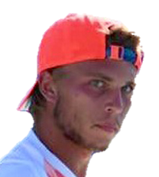
Alexandre
MULLER

Slide 46
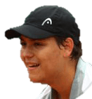
Pavel
KOTOV

Slide 47
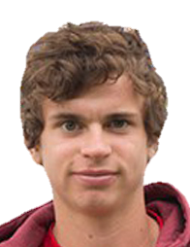
Evan
FURNESS

Slide 48
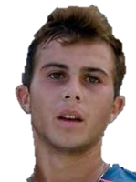
Hugo
GASTON

Slide 49
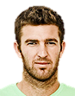
Fabrice
MARTIN

Slide 50
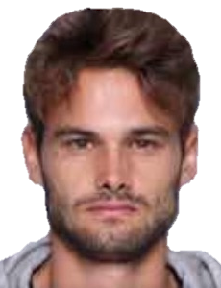
Hugo
NYS

Slide 51

Antoine
CORNUT-CHAUVINC

Slide 52

Jonathan
EYSSERIC

Slide 53

Constantin
BITTOUN-KOUZMINE

Slide 54

Andre
BEGEMANN

Slide 55

Rameez
JUNAID

Slide 56

Scott
CLAYTON

Slide 57

Hugo
VOLJACQUES

Slide 58

Julian
OCLEPPO

Slide 59

Luca
MARGAROLI

Slide 60

Tristan Samuel
WEISSBORN

Slide 61

David FELGATE
COACH

Slide 62

Antonio
SANCIC

Slide 63

Steve
DARCIS

Slide 64

Marc BARBIER
COACH

Slide 65

Thierry ASCIONE
COACH

Slide 66

Olivier BARDEAU
COACH

Slide 67

Olga KOUZMINA
COACH

Slide 68

Francesco ALDI
COACH

Slide 69

Toni COLOM
COACH

Slide 70

Israel VIOR
COACH

Slide 71

David
VEGA HERNANDEZ

Slide 72

Kristof
EHRINGER

Slide 73
Kristof
EHRINGER

Slide 74

Mikhail BRIL
COACH

Slide 75

Jorge MONTESINOS
COACH

Slide 76

Jérome POTIER
COACH

Slide 77

Mihalka ATTILA
COACH

Slide 78

David GUEZ
COACH

Slide 79

Massimo PUCI
COACH

Slide 80

David
PEL

Slide 81
Szymon
WALKOW

Slide 82

Geoffrey
BLANCANEAUX

Slide 83

Adil
SHAMASDIN

Slide 84

Sander
ARENDS

Slide 85

Manuel
GUINARD

Slide 86

Jean Michel PEQUERY
COACH

Slide 87
Cédric RAYNAUD
COACH

Slide 88
Nicolas COPIN
COACH

